Slide 1
DATA ANALYSIS REPORT ON HOTEL BOOKING
SUBMITTED BY:
ROOCHIE

Slide 2
Hotel Booking Dataset consists of 2 hotels
City Hotel
Resort Hotel

Slide 3
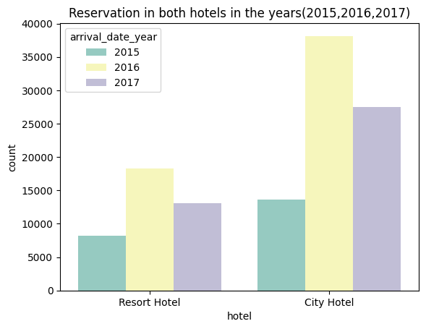
Hotel reservation for year 2015/16/17
City hotel got more reservations as compared to Resort hotel. Max reservation in the year 2016.

Slide 4
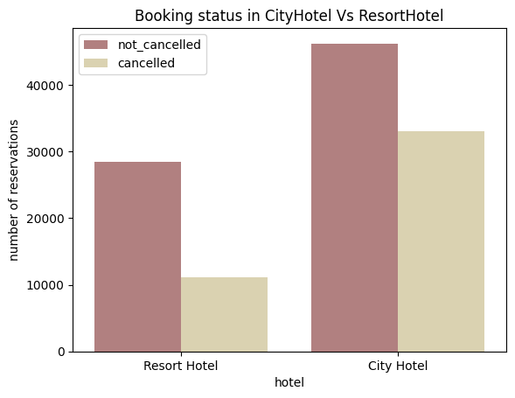
Cancelled vs Not Cancelled Booking status w.r.t hotels
Resort Hotel has less cancellation count.

Slide 5
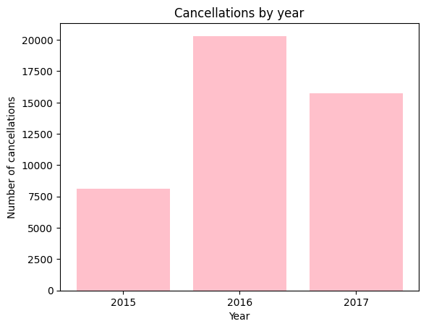
Year-wise cancellation comparison
In the 2016, more cancellation happened.

Slide 6
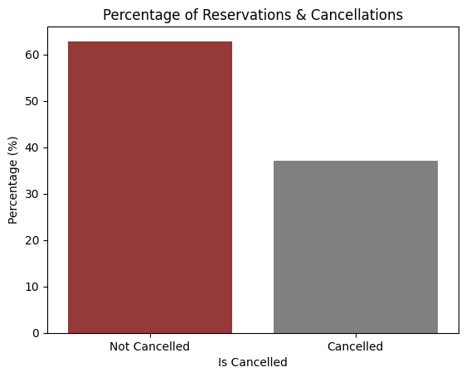
Percentage-wise Reservation status
Findings shows Cancellations are 37% whereas Reservations are 63%

Slide 7
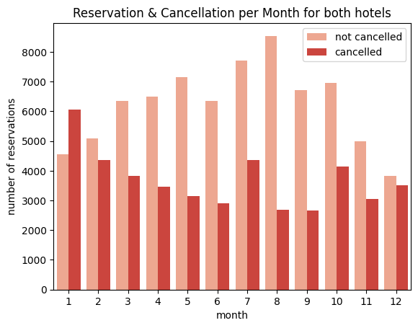
Month-wise Reservation status

Slide 8
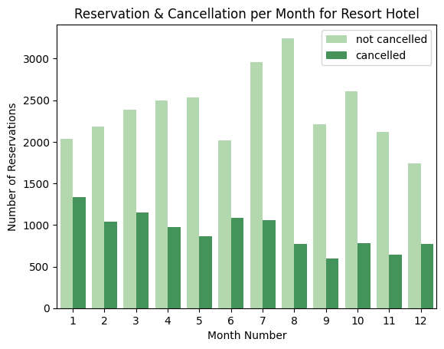
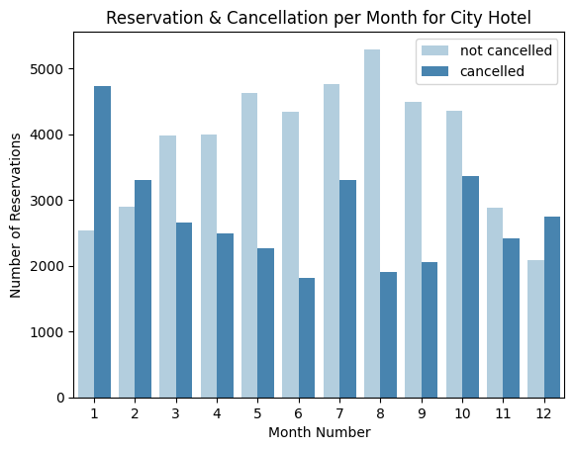
Month-wise comparison of City vs Resort
Lowest cancellation month for Resort Hotel : September
Lowest cancellation month for City Hotel : June
Highest cancellation month for Resort Hotel : January
Highest cancellation month for City Hotel : January

Slide 9
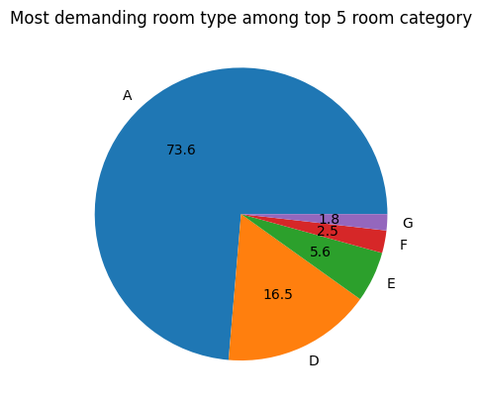
Most demanding room in these years
Room Type A is the most demanding

Slide 10
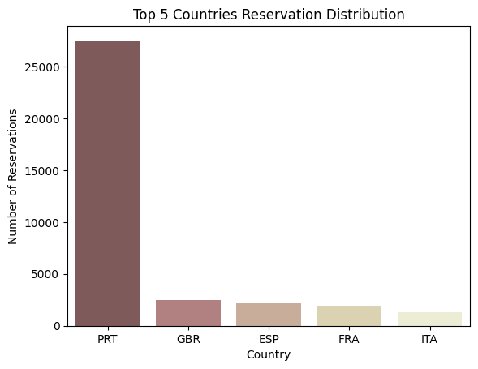
Top five country reservation status
Country labeled as PRT shows more count of reservation.

Slide 11
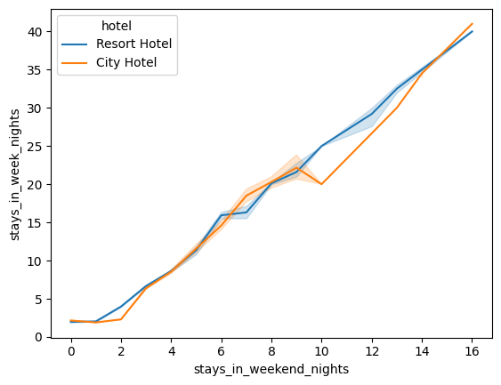
Guests stayed weeknights Vs stayed weekend nights
Resort Hotel line shows more stability for both stayed in weekend and weeknights.

Slide 12
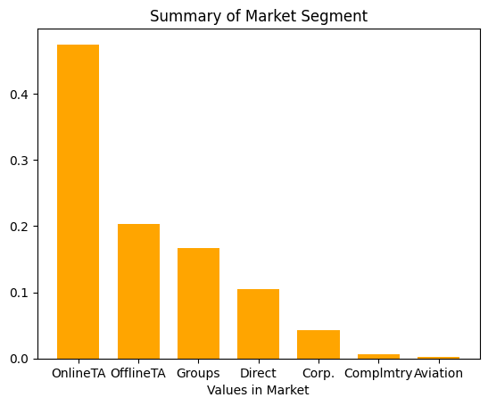
Reservation status as per Market Segment columns distribution
Most of the reservations done by Online TA(47% booking)

Slide 13
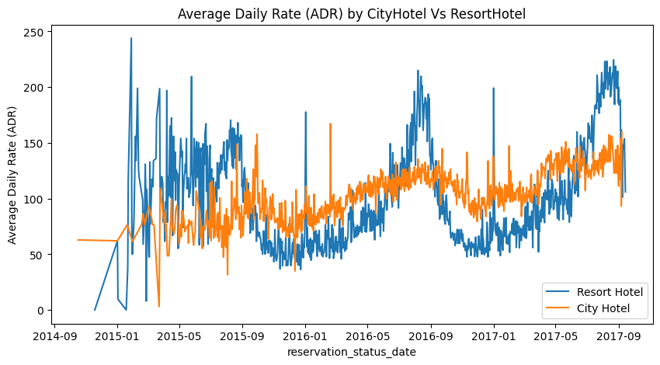
Average Daily Rate
Average Daily Rate (ADR) is a key performance indicator that represents the average room rate that a guest pays per room per day.
ADR of Resort is much higher than City Hotels in some periods.

Slide 14
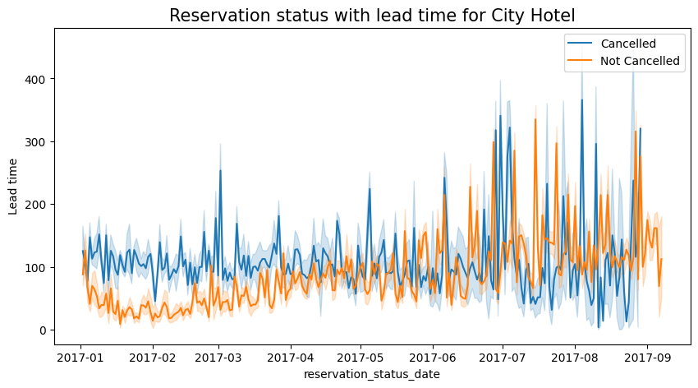
Reservation effect by lead-time for City Hotel

Slide 15
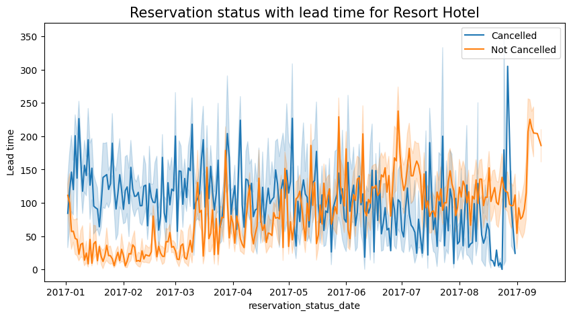
Reservation for year effect by lead-time for Resort Hotel
Longer lead time are leading to more cancellations in resort hotels

Slide 16
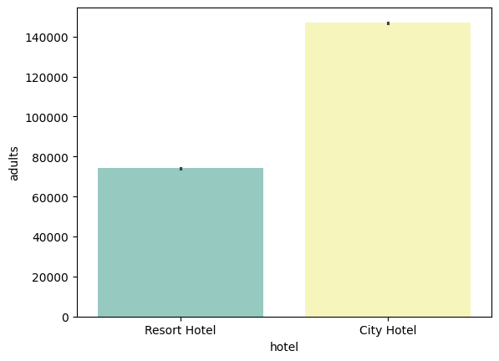
Adults in City Hotel vs Resort Hotel
Findings showed Adults had preference to stayed at City Hotel

Slide 17
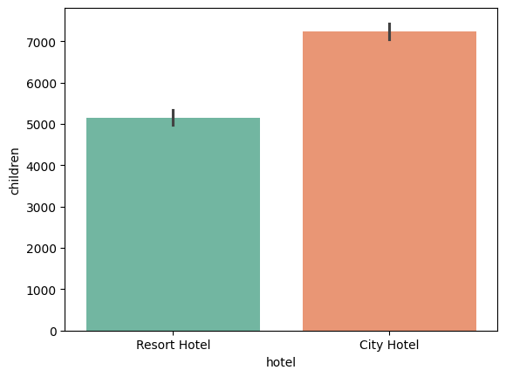
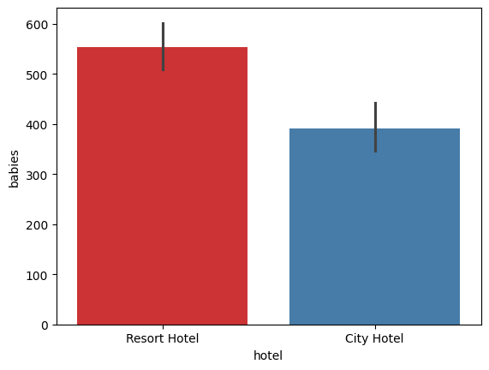
Children and babies in City Hotel Vs Resort Hotel
Families having babies had preference to stayed at Resort Hotel.
Whereas number of children with adults (whether single or couple) stayed at City Hotel.

Slide 18
Thank you…

